Slide 1

French PowerShell & DevOps User Group
2020/04/08

Slide 2

GitHub Actions + PowerShell + Azure
Olivier Miossec

Slide 3
Agenda
French PowerShell & DevOps User Group
GitHub Actions Introduction
GitHub Actions Workflow
GitHub Actions and Docker
Building an image for testing ARM Template with PowerShell
Securely deploy to Azure
Live demo https://github.com/omiossec/Meetup-20200408-FRPSUG

Slide 4
French PowerShell User Group
Site https://frpsug.com/
Twitter @frpsug
Chat
Pendant les meetings: Skype
En tout temps: Slack, sur le channel #French
PowerShell.slack.com
Enregistrement sur: http://slack.poshcode.org/
Principaux Organisateurs
Francois-Xavier Cat (MVP Cloud and Datacenter Management)
Laurent Lienhard
Stephane Van Gulick (MVP Cloud and Datacenter Management)
Olivier Miossec (MVP Azure)
Enregistrement du meeting sera par la suite mis sur Youtube.
Future meetings
Nous recherchons des presentateurs

Slide 5

Olivier Miossec
Microsoft Azure MVP
Co-Animator
French PowerShell & DevOps User Group
Paris PowerShell & WinOps
@omiossec_med
https://github.com/omiossec
https://dev.to/omiossec
https://www.linkedin.com/in/omiossec/
https://about.me/omiossec

Slide 6
GitHub Actions Introduction
GitHub Actions allows you to execute tasks triggered by a GitHub event.
This events can be a Push [Push], a Pull Request [pull_request], a page Build [page_build], a release [release], webhook events, a fork [fork], an update on the wiki [Gollum], a new issue [issue] and issues update [issue_comment], a Schedule [schedule]…
GitHub Actions are created inside a repository. You just need to create a .github/workflows directory at the root of the repository. Any YAML file in the “workflows” directory will be parsed by the GitHub Actions.
Action can be triggered by any branch as long as the branch contains the workflow directory.
Action run on a GitHub hosted runner, a computer running
PowerShell 7 is installed on Linux, Windows and Mac OS.
You can check runner’s configuration here https://github.com/actions/virtual-environments
Windows 2019 | windows-latest
Windows 2016 | windows-2016
Ubuntu 18.04 | ubuntu-latest
Ubuntu 16.04 | ubuntu-16.04
macOS Catalina 10.15 | macos-latest

Slide 7
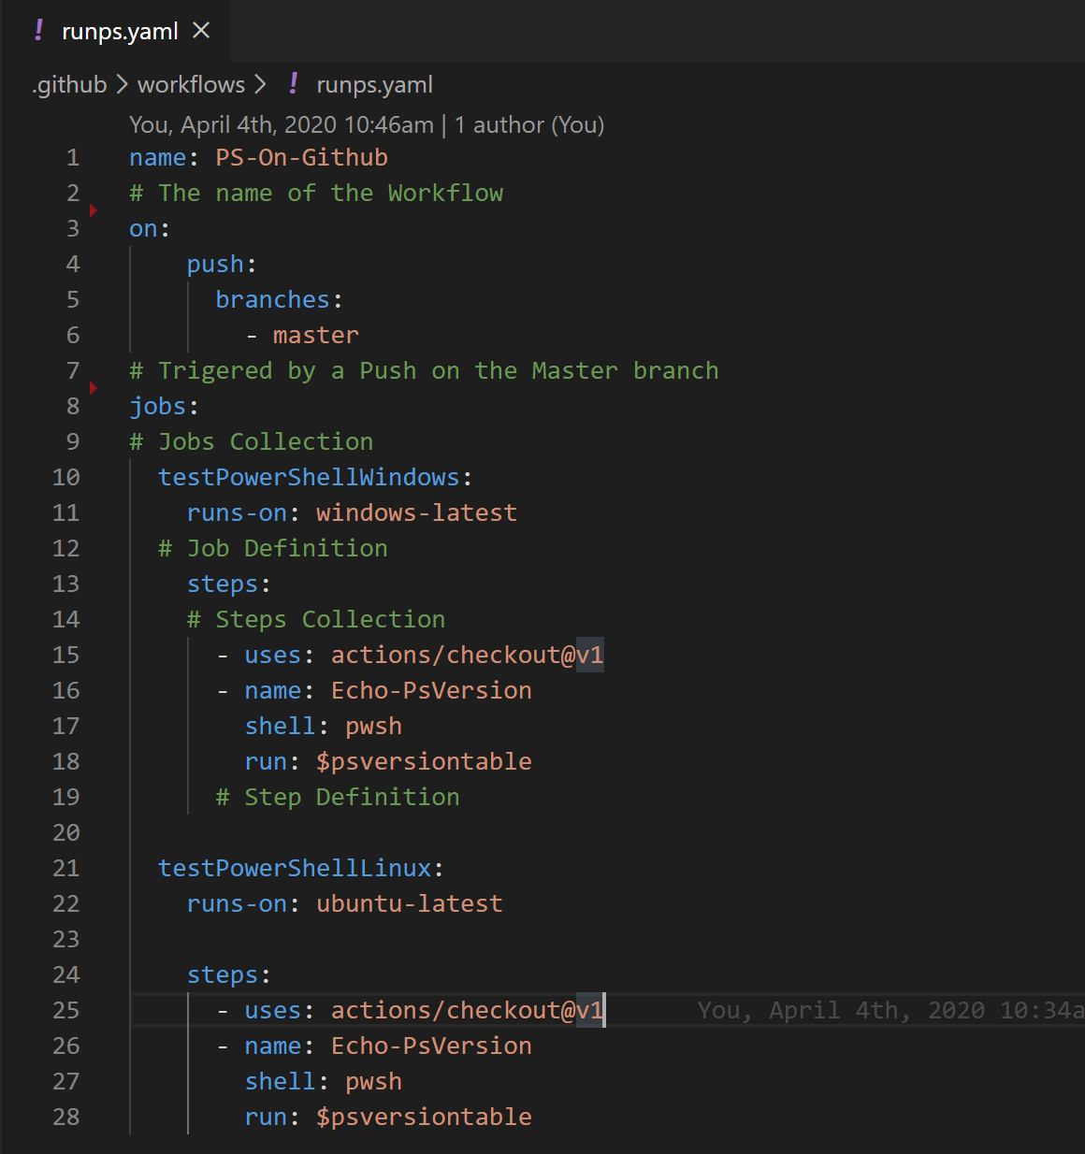
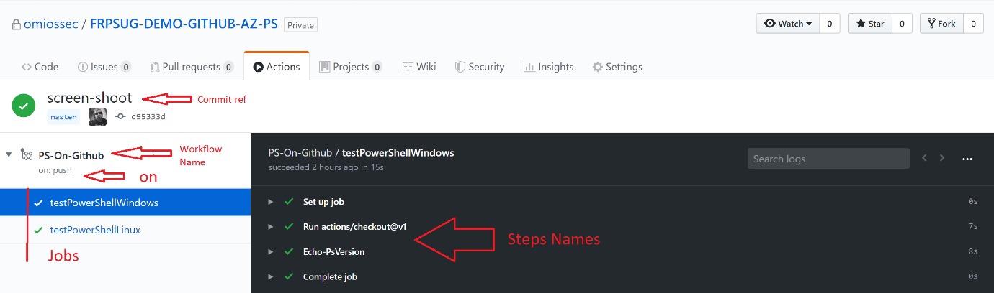
GitHub Actions Workflow
A YAML workflow starts with a name, it can be s single a string or you can use white space
Then the event with the keyword on
Then the Job collections, an array of jobs containing one or more steps

Slide 8
DEMO Run PS on Linux, Windows and MacOs

Slide 9
DEMO Dealing with GitHub Issues with Actions

Slide 10
GitHub Actions and Docker
To create a more complex workflow in GitHub Actions you can start a Docker instance on Linux or Windows.
Using Docker with GitHub Action:
Build complex workflow
Create your environment
Create a reusable workflow
Publish Actions in the Marketplace
To create a Docker GitHub Actions you need a:
A Dockerfile
An action.yaml file to describe how to use the image in a workflow
A script, PowerShell or other. This script will run each time the image starts

Slide 11
Testing ARM Templates with PowerShell
We need:
A Stable image with PowerShell and AZ Module We want the same version of the Az Module
A tool to tests our ARM Template
A way to securely deploy a template to an Azure resource group

Slide 12
Azure PowerShell Docker Images
Official Image from MS
Based on Linux
With PowerShell 7 or PowerShell 6.2 depending on the image tag
You can choose the Azure PowerShell module you need with the image tag
To use it,
docker run -it -v ~/scripts:/src mcr.microsoft.com/azure-powershell pwsh

Slide 13
The ARM-TTK PowerShell Module
Announced at the MS Ignite ARM, ARM Template Tool Kit enable you to test your ARM templates
ARM Template Tool Kit is a PowerShell module and it’s still in preview.
The module is in preview and it’s not available in the PowerShell Gallery
But you can use It by downloading it from GitHub https://github.com/Azure/arm-ttk
The module tests ARM template against several test case to ensure
To use it,
Test-AzTemplate -TemplatePath samples\storage.json

Slide 14
Securely deploy to Azure
You need a connection to Azure to deploy your template
You can’t use a standard account login
You need to create a Service Principal
$ServicePrincipal = New-AzADServicePrincipal -DisplayName "FRPSUG-demo" -SkipAssignment
You will need:
TenantId (Get-AzContext).Tenant.Id
The AppIP $ServicePrincipal.ApplicationId
The Service Principal Secret $SecureStringBinary = [System.Runtime.InteropServices.Marshal]::SecureStringToBSTR($servicePrincipal.Secret)
[System.Runtime.InteropServices.Marshal]::PtrToStringAuto($SecureStringBinary)
You can assign privilege to the identity
New-AzRoleAssignment -RoleDefinitionName contributor -ServicePrincipalName $ServicePrincipal.ApplicationId -ResourceGroupName FRPSUG-DEMO-RG
You can create secret in GitHub

Slide 15
DEMO Test ARM template with Docker

Slide 16
DEMO Deploy to Azure with Docker

Slide 17
References
GitHub Action • https://dev.to/omiossec/getting-started-with-azure-powershell-docker-image-and-github-actions-1g7 • https://help.github.com/en/actions
ARM-TTK • https://github.com/Azure/arm-ttk
• https://dev.to/omiossec/how-to-test-your-azure-arm-template-with-arm-template-toolkit-arm-ttk-2492
ARM Templates • https://docs.microsoft.com/en-us/azure/azure-resource-manager/templates/

